Slide 1
Security is a Thing
Introduction
Introduction
Did it happen before?
Did it happen before?
Risks
Risks
Risks
Risk mitigation
Risk mitigation
Risk mitigation
Conclusion
Conclusion
Conclusion

Slide 2



The speaker
Introduction
Introduction
Did it happen before?
Did it happen before?
Risks
Risks
Risks
Risk mitigation
Risk mitigation
Risk mitigation
Conclusion
Conclusion
Conclusion
Vasco Veloso
vveloso
Portuguese and proud of it.
Worked from the kernel to the cloud.
Wrote a book on x86 assembly.
Built firmware for embedded systems.
Writing and designing software professionally since 1997.
Currently writing and designing Java software with Code Nomads.

Slide 3
What’s in for today?
Introduction
Introduction
Did it happen before?
Did it happen before?
Risks
Risks
Risks
Risk mitigation
Risk mitigation
Risk mitigation
Conclusion
Conclusion
Conclusion
Why is this important?
Did it happen before?
Possible risks.
Risk mitigation.

Slide 4
Why is this important?
Introduction
Introduction
Did it happen before?
Did it happen before?
Risks
Risks
Risks
Risk mitigation
Risk mitigation
Risk mitigation
Conclusion
Conclusion
Conclusion
20 billion connected “Things” in 2020 (Gartner)
20 billion new nodes ripe for attacking.
20 billion new nodes surveilling each and every one of us.
Because everything is connected, then…
Data can be stolen.
Hardware can be hijacked.
Unexpected behaviour can cause havoc.

Slide 5
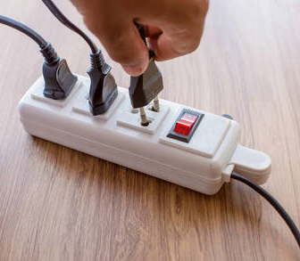
Did it happen before?
Introduction
Introduction
Did it happen before?
Did it happen before?
Risks
Risks
Risks
Risk mitigation
Risk mitigation
Risk mitigation
Conclusion
Conclusion
Conclusion
Belkin's Wemo Insight smartplugs
(August 2018)
The flaw would potentially allow an attacker to not only manipulate the plug itself, but also allow hopping to other devices connected to the same Wi-Fi home network.
The Register
https://securingtomorrow.mcafee.com/mcafee-labs/insight-into-home-automation-reveals-vulnerability-in-simple-iot-product/

Slide 6

Did it happen before?
Introduction
Introduction
Did it happen before?
Did it happen before?
Risks
Risks
Risks
Risk mitigation
Risk mitigation
Risk mitigation
Conclusion
Conclusion
Conclusion
Over 500k routers compromised worldwide
(June 2018)
Attack vector unknown as of June 2018.
VPNFilter malware can sniff traffic, turn the router into a stepstone for its master’s connections, and brick it.
https://arstechnica.com/information-technology/2018/05/hackers-infect-500000-consumer-routers-all-over-the-world-with-malware/

Slide 7
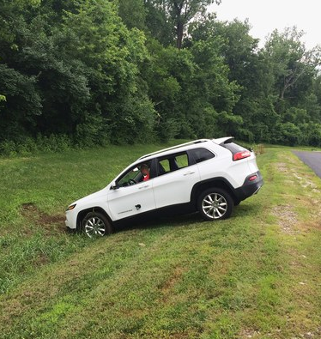
Did it happen before?
Introduction
Introduction
Did it happen before?
Did it happen before?
Risks
Risks
Risks
Risk mitigation
Risk mitigation
Risk mitigation
Conclusion
Conclusion
Conclusion
Jeep hacked remotely
(July 2015)
Zero-day vulnerabilities that allowed remote control of a Jeep Cherokee were demonstrated to the press.
Andy Greenberg / Wired
https://www.wired.com/2015/07/hackers-remotely-kill-jeep-highway/

Slide 8
Did it happen before?
Introduction
Introduction
Did it happen before?
Did it happen before?
Risks
Risks
Risks
Risk mitigation
Risk mitigation
Risk mitigation
Conclusion
Conclusion
Conclusion
Remotely controlled car washes
(July 2017)
Attackers can take control of the machine by leveraging plain text HTTP connections and default credentials.
Physical damage to property and humans becomes possible.
https://motherboard.vice.com/en_us/article/bjxe33/car-wash-hack-can-smash-vehicle-trap-passengers-douse-them-with-water

Slide 9
Did it happen before?
Introduction
Introduction
Did it happen before?
Did it happen before?
Risks
Risks
Risks
Risk mitigation
Risk mitigation
Risk mitigation
Conclusion
Conclusion
Conclusion
Philips Hue lamps were exploited remotely to plant a worm.
An Internet of Things (IoT) botnet of high wattage devices may allow attacks on the power grid.
https://blog.acolyer.org/2017/06/22/iot-goes-nuclear-creating-a-zigbee-chain-reaction/
https://www.usenix.org/conference/usenixsecurity18/presentation/soltan

Slide 10
Risks: Security
Introduction
Introduction
Did it happen before?
Did it happen before?
Risks
Risks
Risks
Risk mitigation
Risk mitigation
Risk mitigation
Conclusion
Conclusion
Conclusion
Device supply chain
Devices may be resold pre-programmed with malware.
Firmware upgrade
OTA may be abused.
Applications and services
Exposed services and end-user applications may be compromised.
Working network
User networks are hostile by definition.
Cloud service impersonation

Slide 11
Risks: Privacy
Introduction
Introduction
Did it happen before?
Did it happen before?
Risks
Risks
Risks
Risk mitigation
Risk mitigation
Risk mitigation
Conclusion
Conclusion
Conclusion
Identity disclosure
Device may transmit personally identifiable data.
Device transmissions may be recognizable.
Location disclosure
Device may transmit its explicit location.
Device may be itself traceable through its communications.
Data confidentiality
Cloud services may contain records full of personally identifiable data.

Slide 12
Mitigation: Physical risk
Introduction
Introduction
Did it happen before?
Did it happen before?
Risks
Risks
Risks
Risk mitigation
Risk mitigation
Risk mitigation
Conclusion
Conclusion
Conclusion
Remove or limit access to debug and programming ports.
Some vendors provide authorization on debug ports.
Re-evaluate vendor designs.
Remove unnecessary connections and peripherals.
Study device flash memory protection mechanisms.
Memory/storage encryption and write control.
Use cryptographic hardware.
Detect tampering attempts.

Slide 13
Mitigation: Software risk
Introduction
Introduction
Did it happen before?
Did it happen before?
Risks
Risks
Risks
Risk mitigation
Risk mitigation
Risk mitigation
Conclusion
Conclusion
Conclusion
Use secure development practices for the platform and language.
Trim and re-evaluate third-party software and libraries.
Use sound and proven cryptographic implementations.
Secure the boot process.
Authenticate OTA update sources and targets.
Have distinct device signatures for software updates.
Pair external devices, such as phones, securely (e.g. secure NFC/Bluetooth).

Slide 14
Mitigation: Network risk
Introduction
Introduction
Did it happen before?
Did it happen before?
Risks
Risks
Risks
Risk mitigation
Risk mitigation
Risk mitigation
Conclusion
Conclusion
Conclusion
Different default credentials for all devices.
Security on the protocol level.
Peer authentication and authorization.
Secret sharing
Cryptographic one-way hashing
Zero knowledge proof
Nodes act only as clients towards the network.

Slide 15
Mitigation: Privacy risk
Introduction
Introduction
Did it happen before?
Did it happen before?
Risks
Risks
Risks
Risk mitigation
Risk mitigation
Risk mitigation
Conclusion
Conclusion
Conclusion
Identity disclosure
Pseudonym.
Connection anonymization.
Location disclosure
Pseudonym.
Data confidentiality
No direct access to personally identifiable data from devices.
Secure data center / cloud resources.

Slide 16
Mitigation: Privacy risk and the GDPR
Introduction
Introduction
Did it happen before?
Did it happen before?
Risks
Risks
Risks
Risk mitigation
Risk mitigation
Risk mitigation
Conclusion
Conclusion
Conclusion
Privacy by design and by default!
Minimize data collection.
Hide data.
Encrypt.
Anonymize.
Pseudonymize.
Control access to data.
Have a privacy policy.
Have means of determining the extent of privacy braches.

Slide 17
Security and privacy first
Introduction
Introduction
Did it happen before?
Did it happen before?
Risks
Risks
Risks
Risk mitigation
Risk mitigation
Risk mitigation
Conclusion
Conclusion
Conclusion
Security and privacy are first-class requirements.
Design from the start with them in mind.
Define trust boundaries
Device/gateway, gateway/cloud, …
Imagine unlawful ways of interacting with the system
Threat modeling

Slide 18
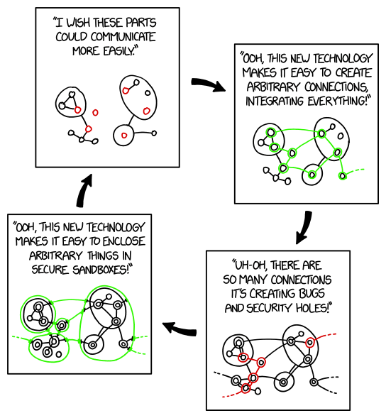
Nothing is unbreakable…
Introduction
Introduction
Did it happen before?
Did it happen before?
Risks
Risks
Risks
Risk mitigation
Risk mitigation
Risk mitigation
Conclusion
Conclusion
Conclusion
… but we can make it more difficult
to break!
Slides and reference papers available at
https://github.com/vveloso/talks
https://xkcd.com/2044/

